Slide 1
4D - Visualizer
Kunal Patel - CF/19

Slide 2
4D - Visualizer
A Tool, To Visualize the 4-Dimensional Euclidean(not space-time) Objects In 3-Dimensional Euclidean Space.
4D objects are visualized by taking its Projection from higher dimension to lower dimension.

Slide 3
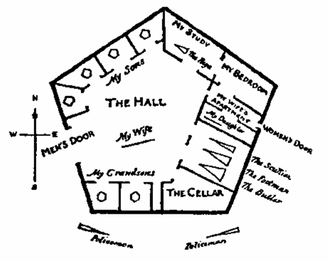
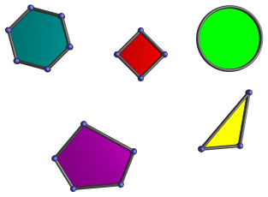
Flat Land: 2D world (x,y)
A novel by Edwin Abbott, 1884

Slide 4
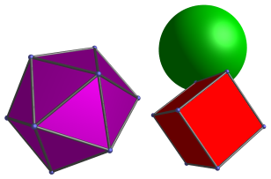

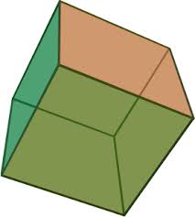
Our 3D world (x,y,z)
3D Cube

Slide 5
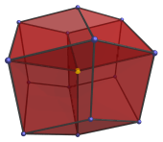
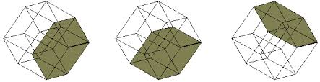
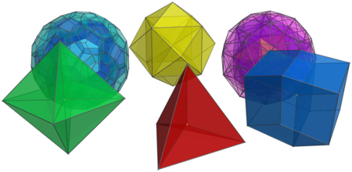
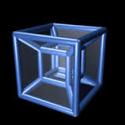
Hypothetical 4D world (x,y,z,w)
4D HyperCube Tesseract

Slide 6
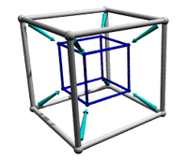
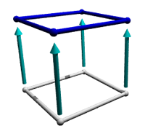

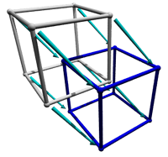


0th to 4th Dimention
0D
4D
3D
1D
2D

Slide 7
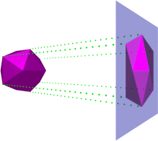
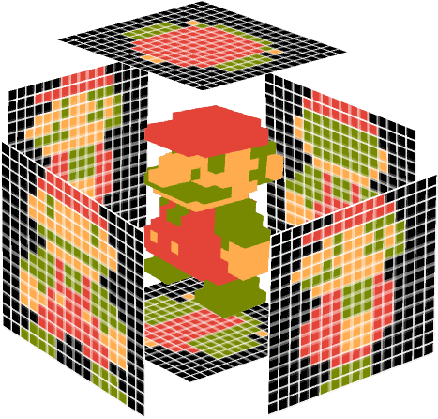
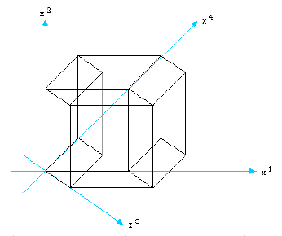
Projection
3D to 2D
4D to 3D

Slide 8
Rotation
The Projection distorts as object rotates in extra dimension to projection plane
Rotation of 2D surface along 3th dimention
Rotation of 3D cube along 4th dimention

Slide 9
4D - Visualizer
Written in Python
numpy to process nodes
matplotlib to plot object in 3D space
Input: 4D geometry, .obj format(points, lines)
Output: Interactive 3D projection of 4D geometry.
Rotation along different Planes in 3D and 4D, to visualize object from different angle .

Slide 10
Demo

